Slide 1

Data Types

Slide 2

Exam Objectives
Working With Java Primitive Data Types
Declare and initialize variables (including casting and promoting primitive data types
Identify the scope of variable.
Use local variable type inference

Slide 3
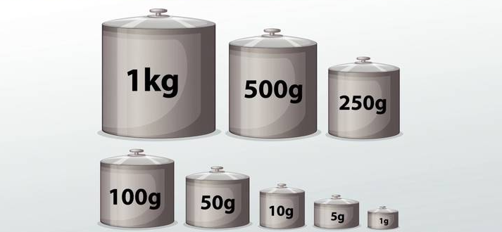
Standard Weights

Slide 4
Data Types
A program is nothing but an exercise in manipulating the data represented by variables and objects.
In order to work with data, every language defines certain basic data types.
Java defines primitive data types :
byte
short
char
int
float
double
boolean

Slide 5
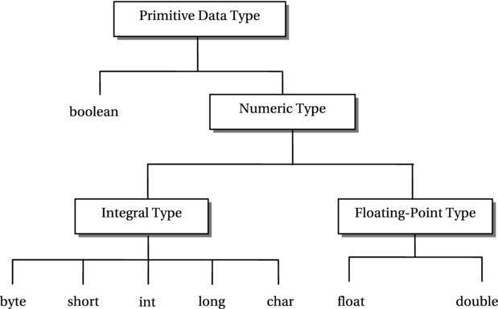
Data type hierarchy

Slide 6
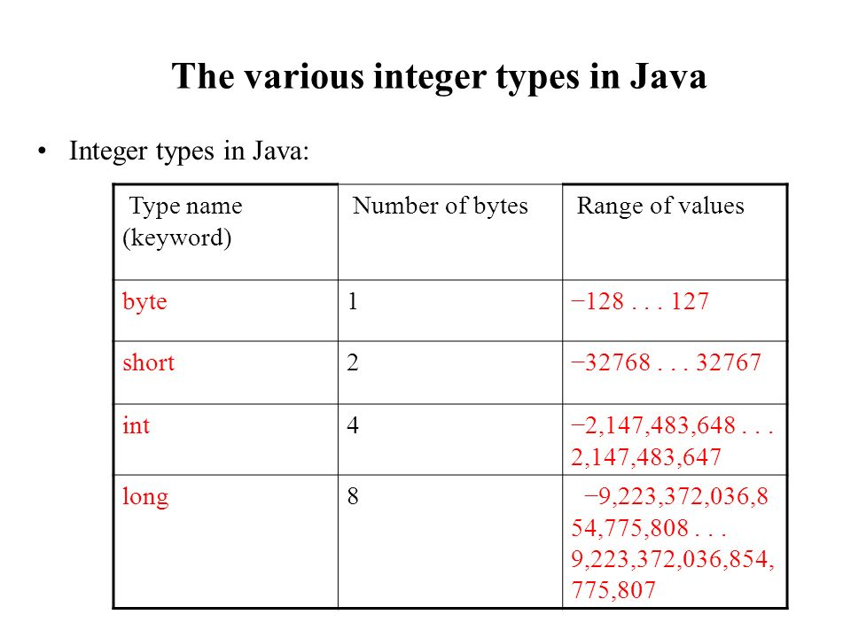
Numeric Data Types
Java numeric data types :
byte
short
char (unsigned)
int
long
Good to know but not required for exam.

Slide 7
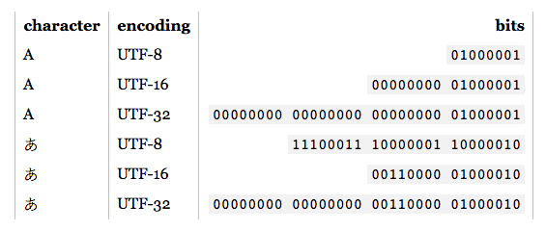
Char: A special case.
Data type char is also an integral data type. It only stores positive integral values.
Numbers stored in char are represented as Unicode character set.
Unicode is written as UTF-8 for 8 bits,UTF-16 for 16 bits & UTF-32 for 32 bits.
Java uses UTF-16 for character representation.

Slide 8
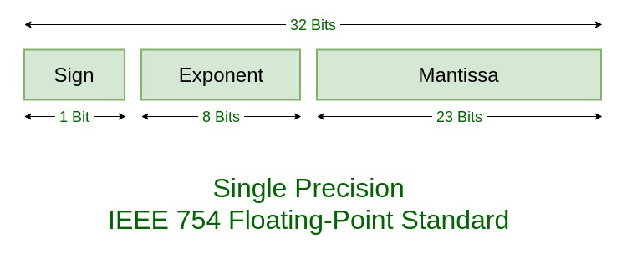
Floating Data Types
Java follows IEEE-754 standard for representation of floating point numbers.
Good to know but not required for exam
float
double

Slide 9
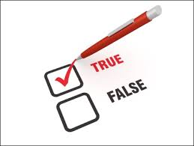
Boolean Data type
A Boolean data type represent value in the form of:
true
False
It majorly used while taking decision and testing for a certain value to be true or false.

Slide 10
Class : User Defined data types
User types are those that are built using the basic primitive data types in java.
A class defines data type which can combine one or more primitive data types or more user defined data types.
Objects are the instances of a class & a reference is used to point to that object . Think of the reference as a pointer to instances of the class.
Objects are created using new keyword while primitive created just by specifying type of variable and its value.
Figure needs to be added by ritika here

Slide 11
Types of variables
There are two types of variables :
Primitives
References
Primitives are the variables that hold the primitive type values. These are also referred to as value types.
Reference variables are those that point to an object/instance of a user defined type.
Just like primitive variables are containers of primitive values similarly object are the containers of user defined data type values and reference variables point to such an obects.
Need a figure here

Slide 12

Reference Variables
Containers of user defined data types are referred to as object/instance. On the other hand reference variables are those that point to these objects.Reference varable do not “contain” the user defined data type values in the same sense as primitive data types.
The relationship between reference variables and an object is similar to that of a kite and the holder of its thread.
If you want to move the kite to the left, then you need to ask the holder of thr thread to pull the thread when the kite points to left direction.

Slide 13
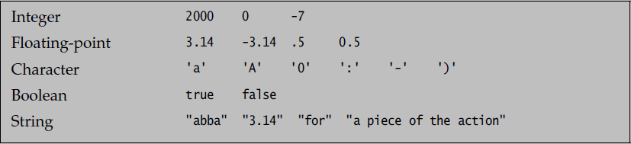
Literals & Keywords
Literals are constant values in Java.
Every data type have their own ways of writing literals.
Integral literals
byte , short, char ,int data types.
int is the default.
Default is demal number systesm.
Can also write numbers in octal (034) and hexadecimal number system.
long values prefixed with a small l.
Float literals.
float and double data types.
Default is double.

Slide 14

Declaring & Initializing Variables
There are many ways we can declare and initialize variables in java.
We can just declare variables without giving them any value or can assign them.

Slide 15

Default Values
All data members of a User defined data type or a class are set to their default values.
Default values are like default factory settings that our phones have. These are the set of most healthy and initial settings that worked.

Slide 16
Primitive Assignments
Figure showing 3 types of assignments. It also shows narrowing/widening , implicit/explicit.

Slide 17
Primitive value Assignment.
Assignment can 3 possibilities :
Both sides are of equal capacity.
Left hand side is larger capacity and right hand side is smaller.
Right hand side is larger capacity and left hand side is smaller.
Case 2 is referred to as widening.
Case 3 is referred to as narrowing.

Slide 18
Widening & Narrowing Conversions.
Assigning value to a higher data type from lower data type is called as widening conversion. Since the larger data type can hold values of a lower data type hence the compiler allows this conversion to happen implicitly. As a result its referred to as implicit widening conversions.
On the other hand assigning a value from a lower data type to a higher data type is referred to as narrowing conversions. Since this type of conversion may result in a loss of information hence compiler does not allow such types of conversion implicitly. In order to make this assignment possible we need to explicitly tell the compiler to make that assignment. This explicit telling to the compiler happens by the way of ‘cast’.
It might also be taken into consideration that if value of higher data type is within the range of the smaller data type then such type of assignment should be allowed. But the compiler has a problems here. The compiler is not the one executing the code & hence it cannot determine the runtime value of the variable which is why it does not allow implicit narrowing here. The only time this happens when compiler finds a compile time constant.

Slide 19
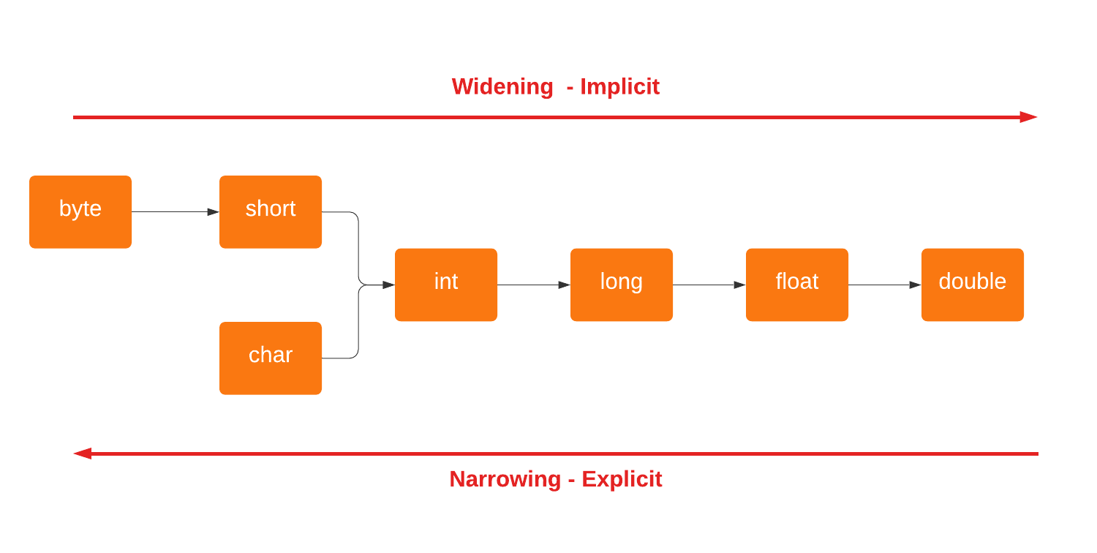
Automatic Type Conversion

Slide 20
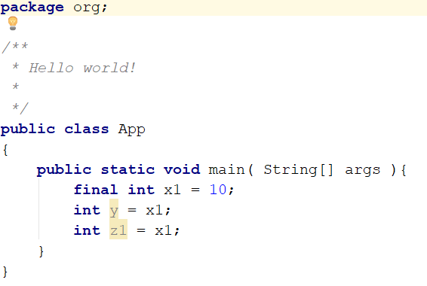
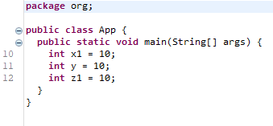
Compile time constants
Compile time constants are variables whose values do not change throughout the course of the program. Hence compiler can definitely know the value of such a value at any point in the program.
Since the value of such a variable is known at the compile time hence compiler allows implicit narrowing in cases where larger data type value lies within the range of lower data type value.
A compile time constant in java is declared using the final keyword.
Ex. final int constantInt = 10;
In the above example value of constantInt is set as final , hence it is a constant variable and it will hold the value 10 throughout the life time of the program
Wherever the constant variable is used in a program the compiler replaces it with exact value of the constant variable. This is depicted in the picture as shown.

Slide 21

Questions ??
a b c

